Slide 1
Paediatric Crisis Management
Anaphylaxis
Massive transfusion protocol
ROTEM guidelines
Pulseless arrest
Pulseless arrest shockable rhythm
Tachycardia
Bradycardia
LA toxicity
Malignant Hyperthermia
Hyperkalemia
Blood transfusion reactions

Slide 2
Paediatric Anaphylaxis (0-12yrs) Initial Management
Cardiac arrest
(Pulseless electrical activity PEA)
Start CPR immediately
10mcg/kg of IV adrenaline, repeat 1-4 min as needed
20ml/kg crystalloid
Advanced life support for non-shockable rhythms
DR
Danger & Diagnosis
Response to Stimulus
Unresponsive hypotension or bronchospasm
Remove triggers eg. latex, chlorhexidine, colloid
Stop procedure. Use minimal volatile/ TIVA if GA
S
Call for help
Organise team
Call for help, press OT code blue button if needed
Assign team leader and scribe
AB
Secure airway
100% Oxygen
Check capnography, no trace = wrong place
Confirm FiO2 100%
Intubate: early airway edema
C
Rapid fluid bolus
Large volume resuscitation
If hypotensive, elevate legs
Bolus 20ml/kg crystalloid, repeat as needed
Large bore IV access, warm IV fluids
D
Adrenaline bolus kiv repeat
Prepare adrenaline infusion
Initial IV adrenaline bolus (0.1mg adrenaline in 10ml NS = 10mcg/mL)
Moderate 1 to 2 mcg/kg
Life threatening 4 to 10 mcg/kg
Peripheral IV adrenaline infusion: dilute 1.5mg adrenaline in 50mL N/S
Concentration: 0.1mcg/kg/min = 0.2mL/kg/hr
IM adrenaline 0.01mL/kg if no IV access (1:1000 = 1mg/mL)
< 6years 0.15ml (150mcg)
6-12 years 0.3mL (300mcg) every 5min, on lateral thigh
>12 yr or adult 0.5mL
Adapted from ANZAAG-ANZCA Perioperative Anaphylaxis Management Guidelines v.14Nov22, doses according to KKH Emergency Medicine guidelines

Slide 3
Paediatric Anaphylaxis
Refractory Management
Triggers removed?
Monitoring
Resistant Hypotension
Additional IV fluid bolus 20-40mL/kg
Continue adrenaline infusion
Add 2nd vasopressor
Consider CVC
TTE / TEE
Additional IV fluid bolus 20-40mL/kg
Noradrenaline infusion 0.1 to 2 mcg/kg/min
Peripheral dilution: 1.5mg noradrenaline in 50mL N/S
Vasopressin infusion 0.02 to 0.06mcg/kg/hour
CVL: 1unit/kg in 50mL, 2mL bolus then 1-3mL/hour
Peripheral access max. concentration = 1unit/mL
Glucagon 20-30mcg/kg IV to max 1mg, over 5min
Resistant Bronchospasm
Consider
Esophageal intubation
Airway device/ Circuit malfunction
Tension pneumothorax
Continue adrenaline infusion
Add alternative bronchodilators
Consider differential diagnosis
Chlorhexidine, including impregnated CVCs
Synthetic colloid
Latex
Consider arterial line
Consider TTE/ TEE
Salbutamol MDI (100mcg/puff)
≤10kg 5 puffs; >10kg 10 puffs
Consider Ipratropium bromide MDI (in MOT ADC)
≤10kg 2 puffs; >10kg 4 puffs
Magnesium sulphate 50%: 50mg/kg dilute in 100ml NS over 20 min, max 2g per dose. (0.1mL/kg 50% solution = 1mg/kg)
Aminophylline 5mg/kg in 50mL N/S over 20min (max 500mg), max peripheral concentration: 2.5mg/mL
Hydrocortisone 2-4mg/kg (max 200mg)

Slide 4
Paediatric Anaphylaxis
Post Crisis Management
Once stabilised
Consider: Proceed / cancel surgery
Postop HD or CICU monitoring
Consider Steroids
IV dexamethasone 0.1-0.4mg/kg
IV hydrocortisone 2-4mg/kg
Consider ORAL anti-histamines
IV anti-histamines not recommended
Investigations
Tryptase, serum
Serum tryptase (paediatric brown top tube, 1.5mL)
1st sample ASAP during the event
2nd sample 1-2h after onset of event
3rd sample 24h after onset
Other investigations as clinically indicated
Referral to allergist
For investigation of anaphylaxis
Monitoring
Monitor closely for 6 hours, consider HD/ICU
Anaphylaxis may persist >24h despite aggressive treatment
ANZAAG-ANZCA Perioperative Anaphylaxis Management Guidelines v.14Nov22

Slide 5
Paediatric Massive Transfusion Protocol
Alpha
Under 10kg
Bravo
10 to 25kg
Charlie
>25 to 40kg
Delta
above 40kg
GXM
Activate MTP from blood bank, document time
FBC, ABG
PT/PTT, Ca
Cycle 1
1 LR PCT
1 FFP
1 platelet (APP)
2 PCT
2 FFP
1 platelet (CSP)
3 PCT
2 FFP
1 platelet (CSP)
4 PCT
2 FFP
1 platelet (CSP)
Cycle 2
1 LR PCT
1 FFP
2 PCT
2 FFP
3 PCT
2 FFP
4 PCT
2 FFP
FBC, ABG
PT/PTT, Ca
1 LR PCT
1 FFP
1 platelet (APP)
1 cryoprecipitate
2 PCT
2 FFP
1 platelet (CSP)
2 cryoprecipitate
3 PCT
2 FFP
1 platelet (CSP)
2 cryoprecipitate
4 PCT
2 FFP
1 platelet (CSP)
2 cryoprecipitate
Repeat at the end of every cycle
Cycle 3
Off-label
Fibrinogen 70mg/kg
PCC 12.5 unit/kg
rFVIIa 40-100mcg/kg
(adults 90mcg/kg)
Review need for blood products to correct coagulopathy or terminate MTP

Slide 6
Paediatric Massive Transfusion Protocol
Indications for MTP
Child given > 40ml/kg fluid bolus or > 20ml/kg blood products
Due to hemorrhagic shock from uncontrolled bleeding
Associated severe head injury/ spinal cord injury
No severe head injury/ spinal cord injury
Keep normal cerebral perfusion pressure; CPP = MAP - ICP
Treat hypotension aggressively
Haemostatic resuscitation with permissive tachycardia
Systolic BP goals
<1month old 60 mmHg
1month to 1yr 70 mmHg
1 to 10 yrs 70 + (age in yrs x 2)
>10 yrs old 90 mmHg
Targets
Temp >35℃, treat hyperthermia aggressively
Platelets > 50k if no significant head injury
> 100k if significant head injury
Blood gases: pH >7.2
BE < -6
Ca >1.1mmol/L
Watch for hyperkalemia
PT/ APTT <1.5x normal, INR ≤ 1.5
Fibrinogen >1.0 g/dL
Lactate < 3 mmol/L

Slide 7
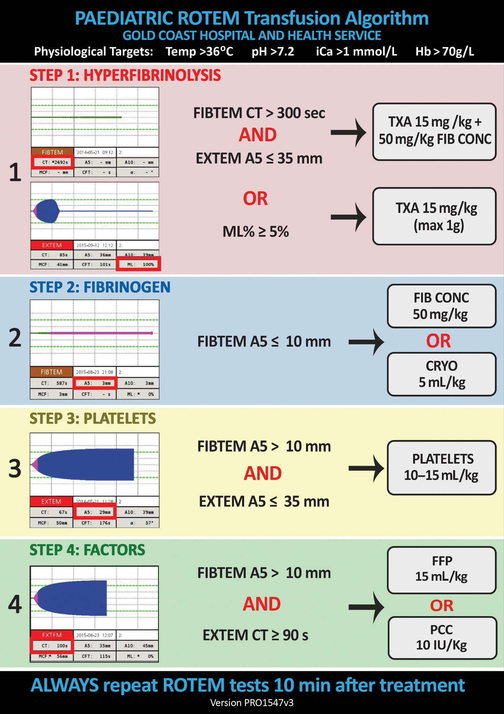
Paediatric ROTEM Transfusion Algorithm
Physiological targets: Temp>36℃ pH >7.2 iCa >1mmol/L Hb >7g/dL
George, S., Wake, E., Sweeny, A., Campbell, D.,Winearls, J. (2022) Rotational thromboelastometry in children presenting to an Australian major trauma centre: A retrospective cohort study. Emergency Medicine Australasia, 34: 590-598

Slide 8
Suggested paediatric ROTEM reference ranges
 | EXTEM |  |  |  |  | INTEM
Age group | CT(s) | CFT (s) | Ɑ (°) | MCF (mm) | LI 30 (%) | CT(s) | CFT (s) | Ɑ (°) | MCF (mm) | ML (%)
Newborns (0-30 days) | 35-70 | 40-150 | 52-82° | 40-80 | 90-100 | 65-135 | 50-220 | 45-75° | 40-70 | 0-15
Infants (1-12 months) | 35-70 | 30-140 | 54-76° | 45-82 | 95-100 | 60-130 | 45-200 | 48-78° | 42-76 | 0-12
Children (1-12 yrs) | 33-69 | 25-120 | 58-78° | 50-84 | 95-100 | 55-120 | 40-180 | 50-80° | 44-78 | 0-10
Adolescents (12-18 yrs) | 33-69 | 20-110 | 60-74° | 55-86 | 97-100 | 50-110 | 35-160 | 52-82° | 46-80 | 0-10
Adults | 38-79 | 34-159 | 63-83° | 50-72 | 94-100 | 100-240 | 30-110 | 70-83° | 50-72 | 0-8

Slide 9
Paediatric Pulseless arrest
Singapore Paediatric Resuscitation Guidelines 2021
Basic life support, give 100% oxygen,
attach monitors/ defib when available
Check pulse & rhythm → Shockable?
For paediatric patients with pre-existing invasive BP monitoring, consider diastolic BP to guide resuscitative efforts.
Infants DBP > 25mmHg
1-12 years > 30mmHg
Above 12 years > 35mmHg
YES = Pulseless VF/ VT
NO = Asystole/ PEA
**Reversible contributing factors (Hs & Ts):
Hypoxia Trauma
Hypovolemia Toxins
H+ ion (acidosis) Tamponade (cardiac)
Hypo/ hyperkalemia Tension pneumothorax
Hypothermia Thrombosis (pulmonary,
Hypoglycemia cardiac)
Post arrest care
A&B: Oxygenation and ventilation
O2: Avoid hypoxia/ hyperoxaemia, keep SpO2 94-98%
CO2: Target appropriate PaCO2, avoid hypocapnia
Circulation
Monitor BP, set hemodynamic goals after ROSC
IV fluids and/or inotropes to maintain SBP above 5th percentile
Disability Treat clinical seizures.
Environment: targeted temperature management
Monitor core temperature & treat fever.
Target normothermia (36 to 37℃)
Glucose control & electrolytes
Avoid hypoglycemia, keep blood glucose >3.5mmol/L
Maintain electrolytes within normal ranges
See pulseless VT/ VF (below)
High quality CPR with ventilation
Obtain IV access with minimal delay
Give adrenaline asap, then q3-5min
IV/IO 0.01mg/kg (0.1mL/kg 1:10,000)
Advanced airway placement
Chest compressions 100-120/min
Ventilation: <1yr 30/min, 1-12yr: 20/min,
>12yr: 10-12/min
Search & treat reversible causes**
Pulseless - shockable
Pulseless - non-shockable OR HR<60/min with hemodynamic compromise
Check pulse & rhythm → Shockable?
Pulse present ≥ 60/min → ROSC

Slide 10
Pulseless arrest with shockable rhythm
Basic life support, give oxygen, attach monitors/ defib when available
Check rhythm → Shockable?
Not shockable = Asystole/ PEA
See asystole/ PEA algorithm
YES = Pulseless VF/ VT
Perform CPR 2min,
check pulse & rhythm
→ Shockable?
Give adrenaline every other shock q3-5min.
1st shock
2-4 J/kg
Resume CPR
2nd shock
4 J/kg
Resume CPR
3rd shock
4 J/kg
Resume CPR
4th shock
4 J/kg
Resume CPR
5th shock
4 J/kg
Resume CPR
6th shock
4 J/kg
Resume CPR
Consider other antiarrhythmics:
IV/ IO lignocaine 1mg/kg followed by infusion 20-50mcg/kg/min (May repeat bolus after 15min, if delay in starting infusion >15min)
IV/ IO amiodarone 5mg/kg, up to 3 times
IV/ IO magnesium sulphate 50mg/kg (max 2g) for torsades des pointes.
Consider increasing energy dose of shocks up to max 10 J/kg for refractory VF
CPR 2min then check pulse & rhythm → Shockable?
Minimise time between compressions & shock delivery
Monitor quality of CPR
Assess & manage for reversible causes
- Hs & Ts**
IV/ IO adrenaline 0.01mg/kg (max 1mg), q3-5min or every other shock
IV/ IO amiodarone 5mg/kg OR IV/ IO lignocaine 1mg/kg (max 100mg) initial bolus, then infusion 20-50mcg/kg/min
IV/ IO adrenaline 0.01mg/kg (max 1mg), q3-5min or every other shock
IV/ IO amiodarone 5mg/kg (max 3 doses) OR IV/ IO lignocaine if not given earlier, 1mg/kg (max 100mg) initial bolus, then infusion 20-50mcg/kg/min
**Search for & treat possible causes:
Hypoxia Trauma
Hypovolemia Toxins
H+ ion (acidosis) Tamponade (cardiac)
Hypo/ Hyperkalemia Tension pneumothorax
Hypothermia Thrombosis (pulmonary,
Hypoglycemia cardiac)
Singapore Paediatric Resuscitation Guidelines 2021

Slide 11
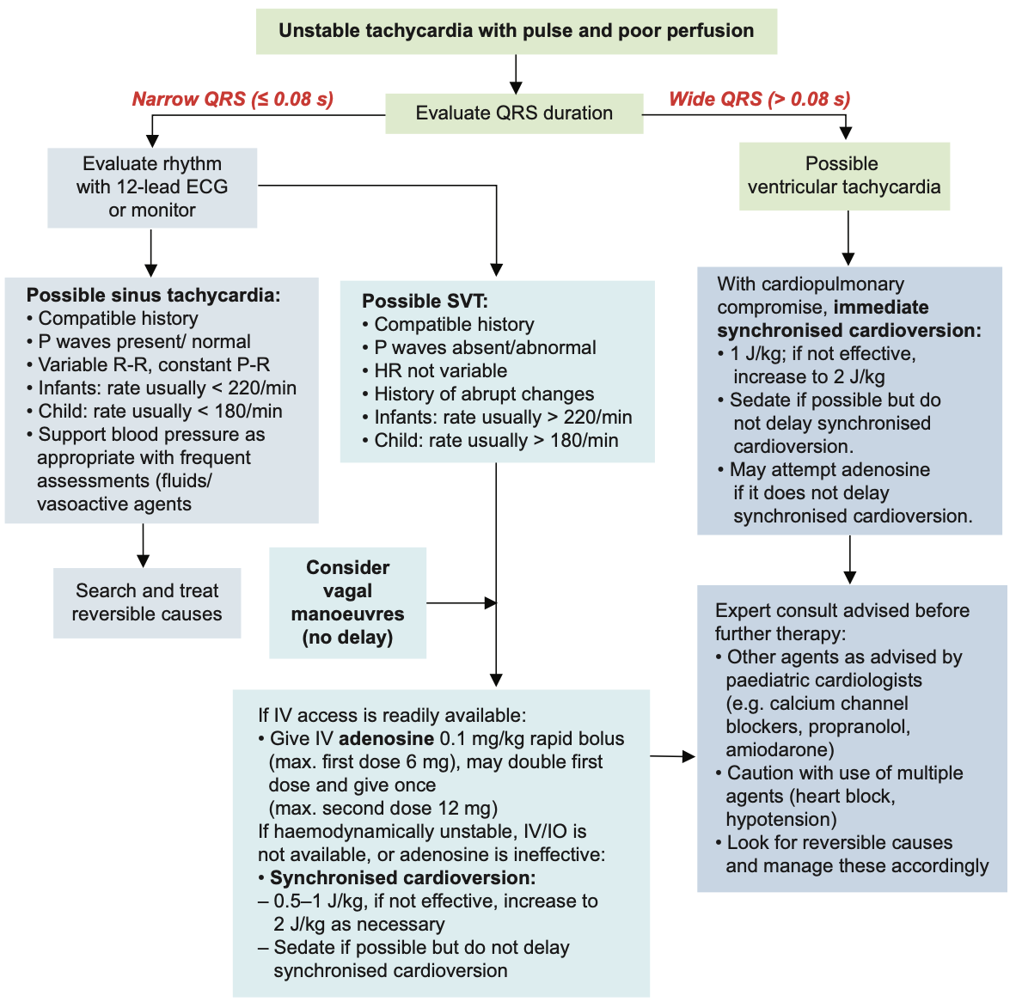
Paediatric Unstable Tachycardia
Singapore Paediatric Resuscitation Guidelines 2021

Slide 12
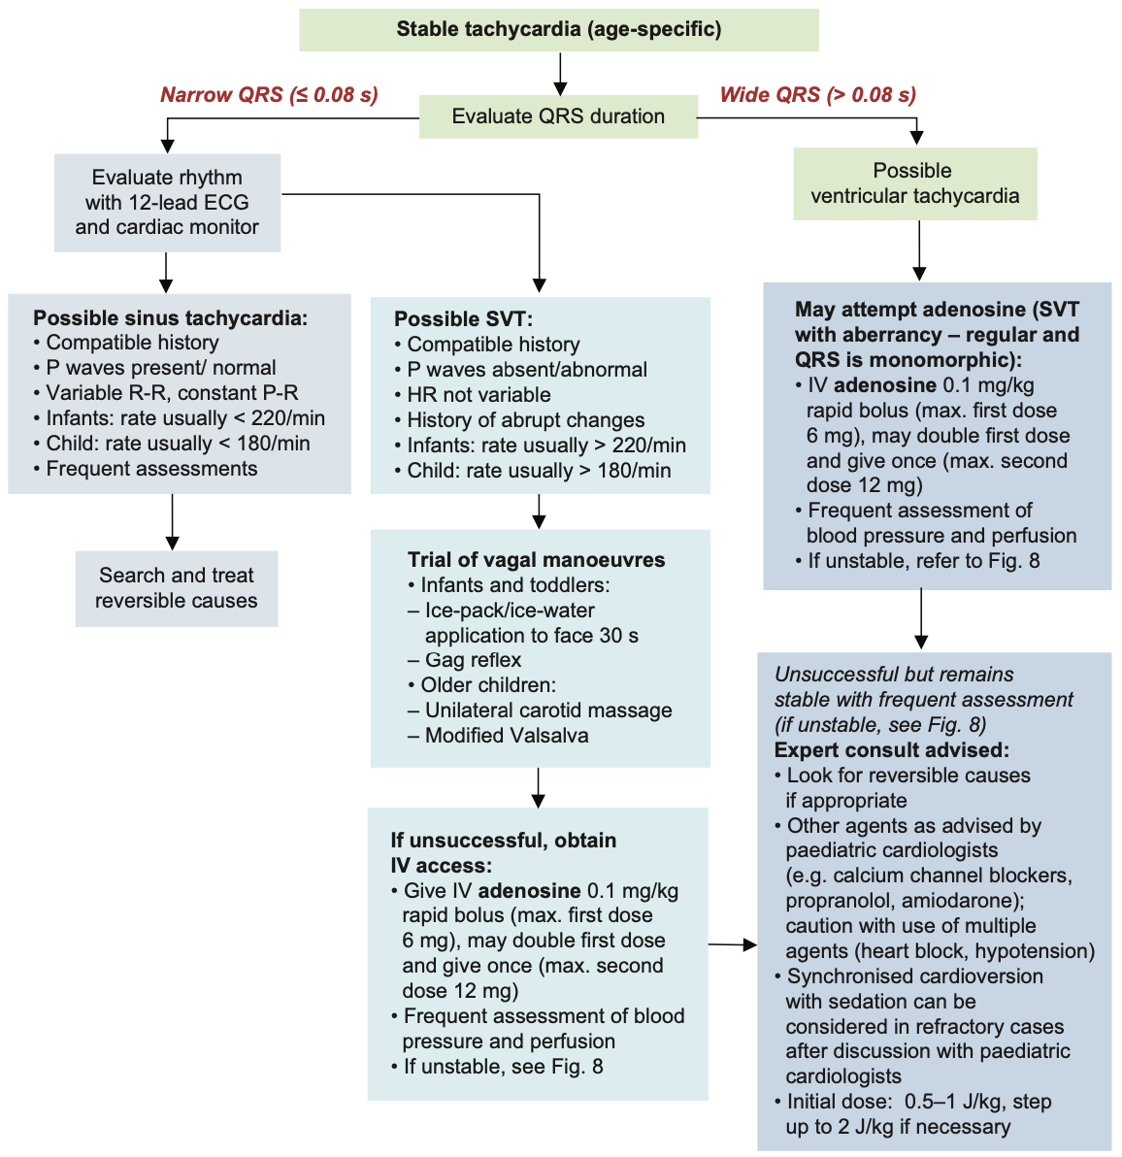
Paediatric Stable Tachycardia
Singapore Paediatric Resuscitation Guidelines 2021

Slide 13
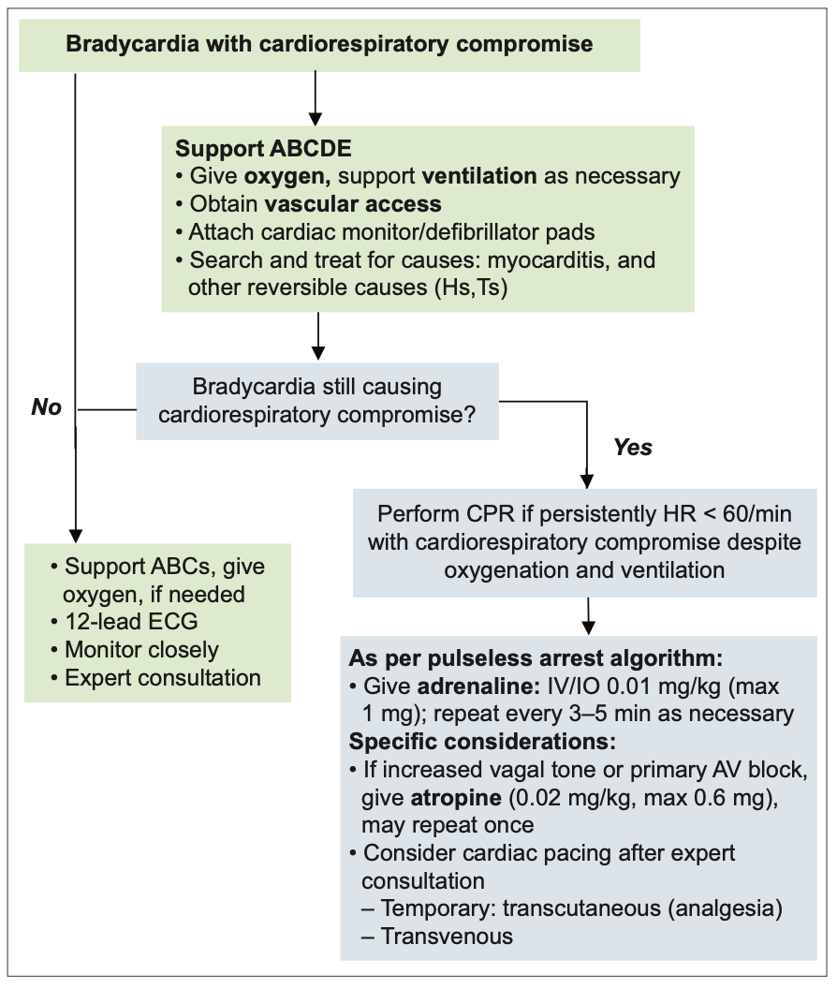
Paediatric Bradycardia
Singapore Paediatric Resuscitation Guidelines 2021

Slide 14
Local Anaesthetic Toxicity
Box A: LIPID EMULSION Regime
Use 20% SMOFlipid® (propofol is not a suitable substitute)
Immediately:
· Give an initial IV bolus of lipid emulsion 1.5 mL/kg over 2-3 min (~100 ml for a 70 kg adult). See drug dosing guide.
· Start an IV infusion of lipid emulsion at 15 ml/kg/h (17.5 mL/min for a 70 kg adult)
At 5 and 10 minutes:
· Give a repeat bolus (same dose) if:
o cardiovascular stability has not been restored or
o an adequate circulation deteriorates
At any time after 5 minutes:
· Double the rate to 30 mL/kg/h if:
o cardiovascular stability has not been restored or
o an adequate circulation deteriorates
Do NOT exceed max cumulative dose 12 mL/kg (70 kg: 840 ml)
1 STOP injecting the LA, remember the infusion pumps.
2 Call for help, inform immediate clinical team of problem
3 Call for cardiac arrest cart, and LA toxicity box.
4 Give 100% oxygen, ensure adequate lung ventilation:
Maintain the airway and intubate if necessary
Avoid hypercarbia - consider mild hyperventilation.
5 Confirm or establish IV access
6 If circulatory arrest:
Start CPR using standard protocols but:
Give IV Lipid emulsion (see Box A)
Use smaller adrenaline dose ≤1mcg/kg instead of 1mg
Avoid vasopressin
Recovery may take >1 hour.
Consider use of cardiopulmonary bypass if available
If no circulatory arrest:
Conventional therapies to treat hypotension, brady & tachy-arrhythmias.
Consider IV lipid emulsion (Box A)
7 Control seizures.
Small incremental dose of IV midazolam 0.05-0.1mg/kg.
Thiopentone or propofol can be used, beware negative inotropic effect
Consider neuromuscular blockade if seizures uncontrolled.
Box B: CRITICAL CHANGES
Cardiac arrest → check already done 1 to 5, then → 6
Box C: After the Event
Arrange safe transfer to appropriate clinical area
Exclude pancreatitis: regular review, daily amylase or lipase
Report as critical incident
Adapted from Association of Anaesthetists 2023. www.anaesthetists.org/qrh

Slide 15
20% IntraLipid dosing guide
Weight (kg) | Initial bolus 1.5ml/kg over 2-3min | Infusion 15ml/kg/hour | At 5 & 10min, give a repeat bolus if: Cardiovascular stability has not been restored OR an adequate circulation deteriorates | Double infusion 30ml/kg/hour | Do NOT exceed max cumulative dose 12ml/kg
3 | 4.5 ml | 45 ml/h |  | 90 ml/h | 36 ml
5 | 7.5 ml | 75 ml/h |  | 150 ml/h | 60 ml
8 | 12 ml | 120 ml/h |  | 240 ml/h | 96 ml
10 | 15 ml | 150 ml/h |  | 300 ml/h | 120 ml
15 | 22.5 ml | 225 ml/h |  | 450 ml/h | 180 ml
20 | 30 ml | 300 ml/h |  | 600 ml/h | 240 ml
25 | 37.5 ml | 375 ml/h |  | 750 ml/h | 300 ml
30 | 45 ml | 450 ml/h |  | 900 ml/h | 360 ml
40 | 60 ml | 600 ml/h |  | 1200 ml/h (max rate of BBraun infusion pump) | 480 ml
50 | 75 ml | 750 ml/h |  |  | 600 ml
60 | 90 ml | 900 ml/h |  |  | 720 ml
70 | 105 ml | 1050 ml/h |  |  | 840 ml

Slide 16
Malignant Hyperthermia
Box A: ELIMINATE TRIGGER DRUG
Turn off vaporisers & remove from anaesthesia workstation
Set fresh gas flow to 100% oxygen, 15L/min
Hyperventilate 2-3x normal minute ventilation
Place activated charcoal filters on both limbs of breathing circuit
Change soda lime & breathing circuit if feasible (not a priority)
1 Declare Code Blue and MH Crisis, note the time.
2 Aim to abandon or finish surgery as soon as possible.
3 Call for MH box/dantrolene and cardiac arrest trolley.
4 Maintain anaesthesia with TIVA..
5 Allocate enough staff to perform 6 , 7 and 8 simultaneously:
6 Eliminate trigger drug (Box A). Hyperventilate 15L/min 100% O2. Insert activated charcoal filters on inspiratory & expiratory limbs of breathing circuit.
7 Give Dantrolene (Box B).
8 Begin active body cooling (Box C)
9 Additional monitors: invasive BP, CVP, core & peripheral temp, urine output
10 Send urgent labs: ABG, U&E, glucose, FBC, PT/PTT, urinary pH, creatine kinase (peak 12-24h). Repeat as indicated.
11 Seek and treat complications (Box D).
12 Continue ventilation and plan ICU admission. Further dantrolene may be needed. (Ensure plan exists to counsel patient and family)
Box B: DANTROLENE - delegate mixing
2-3mg/kg immediate IV bolus (adult approx 200mg)
Repeat 1mg/kg every 5min, until EtCO2 < 50mmHg & temp <38.5
Pause & observe
Repeat 1mg/kg to maintain EtCO2 < 50mmHg & temp <38.5, even if ‘exceeds’ maximum dose 10mg/kg
Box C: ACTIVE COOLING
Turn OFF active warming
Apply ICE to axillae & groins
Use cold IV fluids, consider cold peritoneal lavage
Consider surface cooling devices, intravascular devices, extracorporeal heat exchange
Box D: COMPLICATIONS & TREATMENTS
Metabolic acidosis: 0.5-1mL/kg sodium bicarbonate 8.4% if pH < 7.2
Hyperkalemia: 0.5-1mL/kg sodium bicarbonate 8.4%, 10% Dextrose 5mL/kg with 0.1unit/kg insulin (actrapid), IV calcium gluconate 0.3mL/kg
Myoglobinuria: Forced alkaline diuresis, aim UOP > 2mL/kg, urine pH >7.
DIC: FFP, cryoprecipitate, platelets
Tachyarrhythmias: amiodarone, beta blockers. AVOID Ca-channel blockers.
DANTROLENE STOCK
Located at:
Adapted from Association of Anaesthetists 2023. www.anaesthetists.org/qrh

Slide 17
Dantrolene dosing guide
(Dilute 20mg dantrolene in 60ml sterile water)
Wt (kg) | Initial bolus 3mg/kg | Repeat 1mg/kg q5min | Max dose 10mg/kg
3 | 9 mg (27mL) | 3 mg (9 mL) | 30 mg (90 mL)
5 | 15 mg (45 mL) | 5 mg (15 mL) | 50 mg (150 mL)
8 | 24 mg (72 mL) | 8 mg (24 mL) | 80 mg (240 mL)
10 | 30 mg (90 mL) | 10 mg (30 mL) | 100 mg (300 mL)
15 | 45 mg (135 mL) | 15 mg (45 mL) | 150 mg (450 mL)
20 | 60 mg (180 mL) | 20 mg (60 mL) | 200 mg (600 mL)
25 | 75 mg (225 mL) | 25 mg (75 mL) | 250 mg (750 mL)
30 | 90 mg (270 mL) | 30 mg (90 mL) | 300 mg (900 mL)
40 | 120 mg (360 mL) | 40 mg (120 mL) | 400 mg (1200 mL)
50 | 150 mg (450 mL) | 50 mg (150 mL) | 500 mg (1500 mL)
60 | 180 mg (540 mL) | 60 mg (180 mL) | 600 mg (1800 mL)
70 | 210 mg (630 mL) | 70 mg (210 mL) | 700 mg (2100 mL)
80 | 240 mg (720 mL) | 80 mg (240 mL) | 800 mg (2400 mL)

Slide 18
Emergency treatment of Hyperkalemia (term infants & children)
Age> 1mo & K ≥5.5
Age ≤ 1mo & K ≥ 6
K+ 5.5 to 6 mmol/L
K+ 6.1 to 6.9 mmol/L
K+ 7mmol/L or ECG abnormal
1. Salbutamol via MDI
2. If pH<7.25, consider
IV sodium bicarbonate 1mL/kg/dose over 10-15min, diluted to 4.2% solution
3. PR/ oral resonium 1g/kg/dose
Cardiac monitoring
Inform senior anaesthetist
1. Salbutamol via MDI
2. IV dextrose/Soluble insulin (actrapid)**
3. Consider IV calcium
gluconate 0.5-1mL/kg
4. If pH<7.25, IV sodium
bicarbonate 1mL/kg over 10 to 15min, diluted to 4.2% solution
5. ± IV frusemide 1-2mg/kg
Cardiac monitoring
Inform senior anaesthetist kiv CICU
1. IV Calcium gluconate 0.5-1ml/kg
or calcium chloride 0.2mL/kg over 10min (if central access)
2. Salbutamol via MDI
3. IV dextrose/ insulin (actrapid)**
4. IV sodium bicarbonate if
pH <7.25, 1mL/kg over 10-15min, diluted to 4.2% solution +/- hyperventilation
5. Consider IV frusemide 1-2mg/kg
Initial treatment
Do ECG
Stop K+ containing fluids
Review K+ in 1 hour
Further treatment
K+ improving → monitor until
normalised
K+ 5.5-6 → repeat salbutamol
MDI
K+ NOT improving
Re-evaluate cause
K+ > 6 mmol/L → escalate to next level of treatment
Review K+ & glucose in 1 hour
Review K+, glucose & ECG in 30min
Hyperkalemia kit
K+ improving → monitor until
normalised
K+ 5.5 to 6.9 → repeat MDI Salbutamol ± dextrose/ insulin (actrapid)** until normal
K+ NOT improving
Re-evaluate cause
K+ > 6.9 → escalate to next level of treatment
K+ improving → monitor till normal
K+ 5.5 to 6 → can repeat Salbutamol MDI ± dextrose/insulin (actrapid)** until normal.
K+ NOT improving
Re-evaluate for cause
ECG changes persist → can repeat calcium
Consider CRRT
** IV Dextrose 10% 5mL/kg per dose
** IV Soluble Insulin 0.1unit/kg per dose (max 10units/dose) Take 50units in insulin syringe, dilute to 50ml, to final concentration of 1unit per mL. Administer appropriate dose using diluted solution.

Slide 19
Hyperkalemia Dosage Guidelines
Insulin and dextrose dosage guidelines for management of hyperkalemia in PRE-TERM neonate
DRUG | ROUTE | DOSE | SPECIAL INSTRUCTIONS
ACTRAPID (Soluble Insulin) | IV INFUSION | 0.2 UNITS/KG/HR | SOLUTION A Take 25 units of Actrapid using INSULIN SYRINGE and reconstitute to 25 ml with Dextrose 5% in the 20 ml syringe. SOLUTION B Draw 5 X BWT (kg) in mls of Solution A and reconstitute to 50 ml with Dextrose 5% in the 50ml syringe. Run Solution B at 2 ml/hr with Dextrose 10% infusion. Discard Solution A
Dextrose 10% | IV INFUSION | 5 ML/KG/HR | Run with Solution B simultaneously.
Review serum K+, hypocount and ECG in 30 minutes.
Insulin and Dextrose Dosage Guidelines for Management of Hyperkalemia in TERM NEONATES, INFANTS & CHILDREN
DRUG | ROUTE | DOSE | SPECIAL INSTRUCTIONS
ACTRAPID (Soluble Insulin) | IV BOLUS | 0.1 UNIT/KG | Take 50 units of Actrapid using INSULIN SYRINGE and reconstitute to 50 ml with NaCL 0.9% in the 50ml syringe. Final concentration is 1 unit/ml. Draw 0.1 X BWT (kg) in mls from the diluted solution (max 10 units). BWT ≤ 30 kg draw into 3ml syringe. BWT > 30 kg draw into 10ml syringe. Give as a bolus after starting the Dextrose 10%.
Dextrose 10% | IV INFUSION | 5 ML/KG | Run Dextrose 10% over 20 minutes.
Review serum K+, hypocount and/or ECG in 30 minutes.

Slide 20
Suspected adverse blood transfusion reaction
Fever/ Chills
Acute Hemolytic Reaction
Bacterial contamination
Febrile Non-hemolytic transfusion reaction
Specimens for Transfusion reaction workup
Return the blood product pack + infusion to the blood bank and report the reaction to the blood bank
Draw blood for transfusion investigations. Send 1st specimen immediately after and the 2nd specimen 24 hours later
Use tube sizes appropriate to patient’s age
Hives/ Urticaria
Mild allergic reaction
Anaphylaxis/anaphylactoid (with respiratory symptoms and/or hypotension
Dyspnea
TRALI
Anaphylactoid/ anaphylactic
Transfusion related circulatory overload
Acute hemolytic reaction
TRALI
Anaphylactoid/ anaphylaxis
Bacterial contamination
Hypotension
All suspected transfusion reactions must be reported to the Blood bank.
Stop blood transfusion temporarily, flush IV line with 0.9% saline.
Monitor patient’s vital signs.
Repeat check the blood unit, patient’s details (e.g. name and date of birth) on patient’s wristband & transfusion slip to confirm details are correct. Review expiry date on blood unit.
Coordinate with Blood bank regarding: 1) samples to be collected for investigation of suspected transfusion reaction and 2) further transfusion.

